Slide 1
Having Fun with English Songs
A Selective Program aimed to teach English with songs

Slide 2
About myself
Edward Ni, a beginner teacher in Feng Hsin Senior High.
offered two selective courses with my colleagues.
Instructed project-based global learning activities.

Slide 3
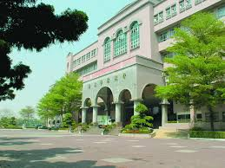
National Feng Hsin Senior High School
A school with pink beautiful campus.
Average English proficiency is intermediate
Innovational teaching is encouraged.
Click for more information

Slide 4
My Classwork 1 – Try to Sing
For this classwork, students are expected to:
Fill in the blanks while listening to an English pop song.
Come up with their own answers for group discussion.
Rehearse and come up to the stage to sing in a group.
I have assigned 6 to 7 songs for the classwork, most of them are specifically chosen from pop music appealing to younger generation.

Slide 5
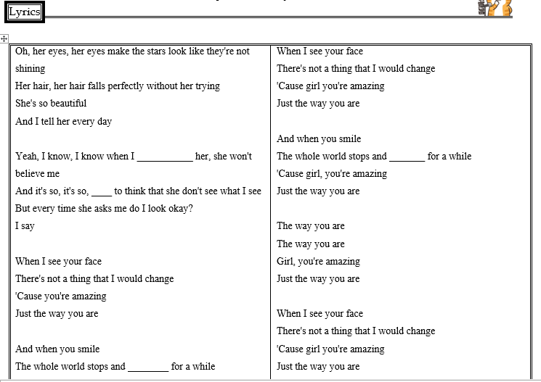
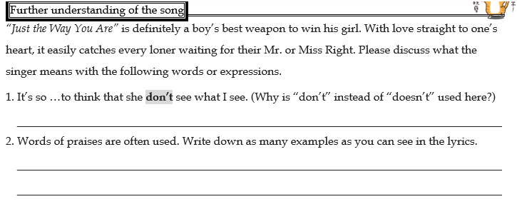
My Classwork Example
Just the way you are
To see the worksheet

Slide 6
My Classwork 2 – Lyrics Composition
For this classwork, students are expected to:
Choose one catchy Mandarin song
Compose English lyrics for the chosen song.
Rehearse and come up to the stage to sing in a group.
Many students find it rather difficult to have correspondent English phrases to express the meaning of the lyrics in another language.

Slide 7
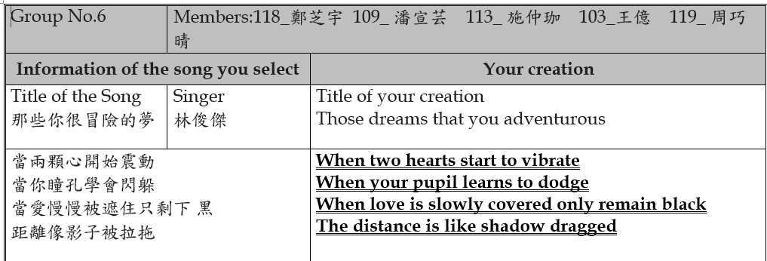
My Classwork Example
The Mandarin Song 那些你很冒險的夢
To see the worksheet

Slide 8
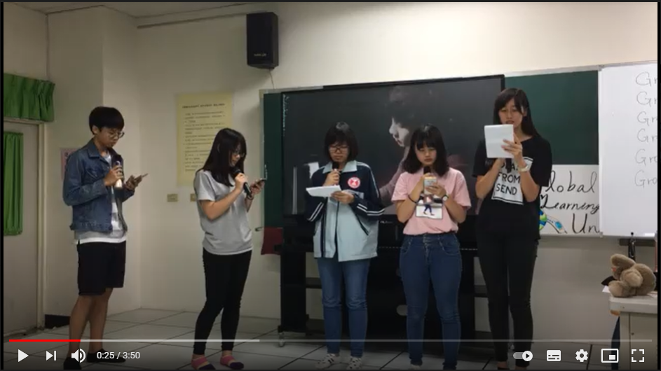
My Classwork Example Students’ Performance

Slide 9
My Classwork 3 – Music Video
For this classwork, students are expected to:
Choose one English song and record the song by the whole group
Write a script for the song and put it into a play.
Produce and edit a music video for the song.
Many students find it interesting to write the plot, edit conversations between roles, and choose the scenes that best match the melody and messages conveyed by the songs.

Slide 10
My Classwork Example

Slide 11
Thank you
Your life is a song.
Just sing it!

